Slide 1
COMP 41400 Multi-Agent Systems (MAS) Lectures 13 & 14 Social Robotics
Professor Gregory O’Hare,
Principal Investigator CONSUS (Crop OptimisatioN through Sensing, Understanding & viSualisation),
School of Computer Science
University College Dublin (UCD)

Slide 2
Social Embodiment
As cognitive science too often neglects the question of physical embodiment, it similarly has neglected the concept of embodiment in a social environment.
As indicated by Edmonds, it is argued that:
“social intelligence is not merely intelligence plus interaction, but should allow for individual relationships to develop between agents”.

Slide 3
The Social Robot
Social Robot:
“A physical entity embodied in a complex, dynamic, and social environment sufficiently empowered to behave in a manner conducive to its own goals and those of its community”

Slide 4
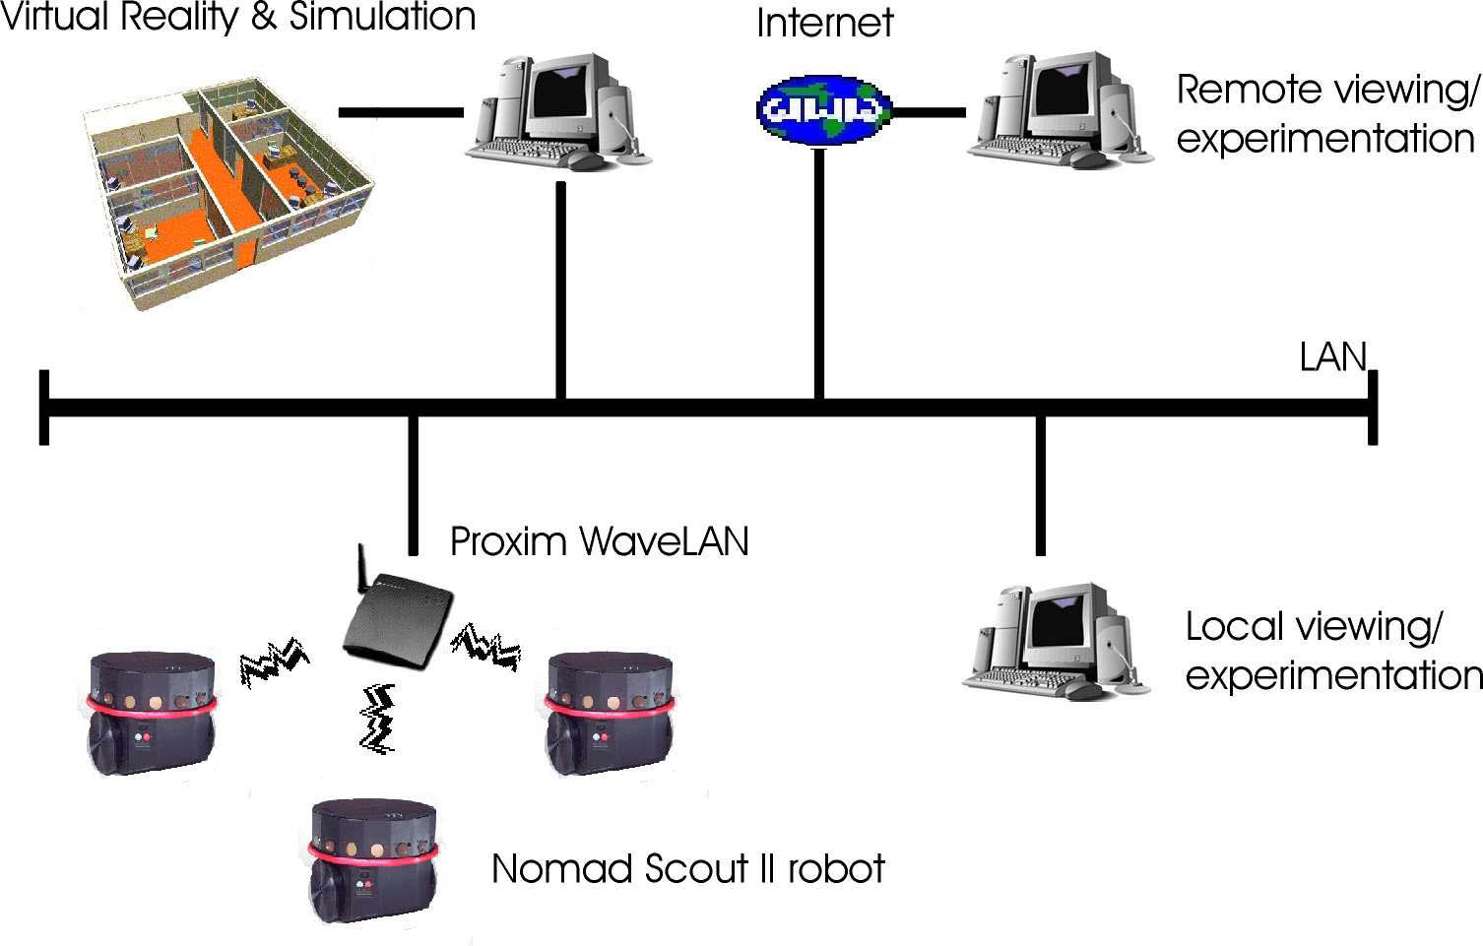
The Coherent Whole

Slide 5
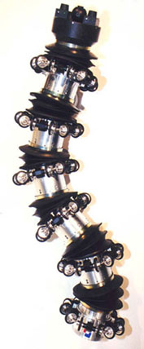
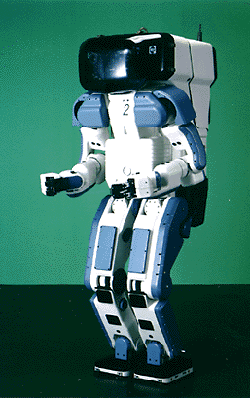
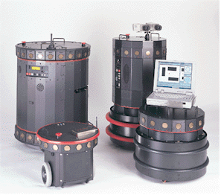
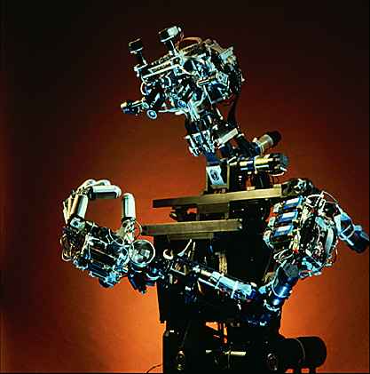
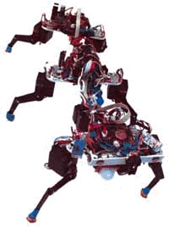
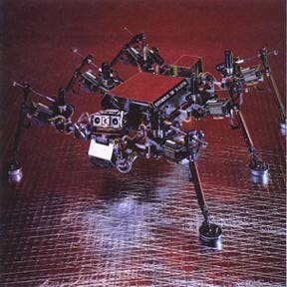
Robot Technologies
View Leading Robotic Offerings Here:
https://www.youtube.com/watch?v=6feEE716UEk

Slide 6
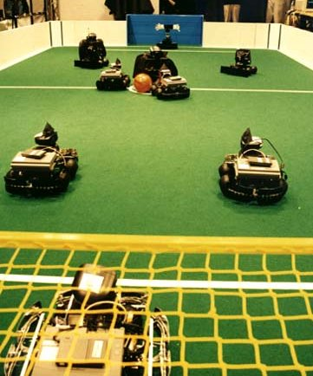
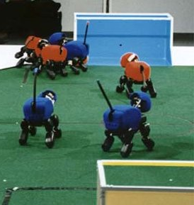
Social Robot Technologies
RoboCup
Fundamental Research
Fukuda Lab (Robotics)
Uni. of Reading / Edinburgh: K. Dautenhahn, A. Billard (Alife)
Manchester Metropolitan Uni, CPM: Bruce Edmonds (Mgmt & business - Socially Situated Intelligence, Embeddedness)
University of Oregon: Social Interaction Lab (Psychology)

Slide 7
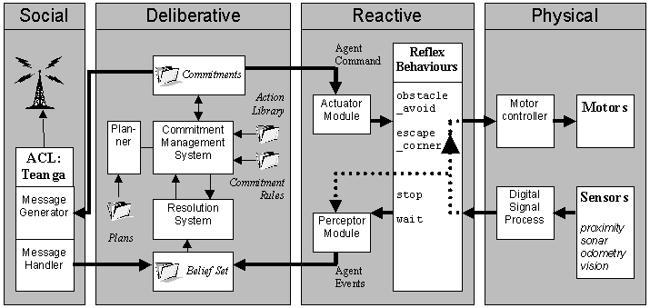
The Social Robot Architecture

Slide 8
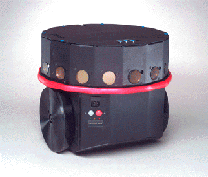
The Physical Layer
3x Nomad Scout II
mobile autonomous robot
ultrasonic and tactile, odometric sensing modules (colour vision soon to be integrated)
Wireless ethernet communication: Mercury-RF1 - 2.4 GHz Wireless Serial Network Interface with TCP/IP
Toshiba laptop
Proxim RangeLAN wireless ethernet

Slide 9
The Reactive Layer
Real-World is unstructured
Fast reflex reactions to unforeseen events
Survival behaviours:
avoid_obstacle
stop
escape_corner
retreat

Slide 10
The Deliberative Layer
Agent Factory Development Toolkit
Belief-Desire-Intention Architecture
Perception
Agent_Events & Communication
Belief (update belief set)
Commitment (adopt or re-evaluate)
Action
Fully autonomous control

Slide 11
The Social Level
Agent Communication Language: “Teanga”
Message handler & generator
Social interaction between a community of robots
REQUEST print(document)
SPEAKER
HEARER

Slide 12
Teanga
SPEECH ACT(Aengus Bodan) (INFORM BELIEF Bel(wall_from(x1y1;x2y2)) now)
SPEECH ACT(Bodan Bui) (REQUEST ACHIEVE follow_wall(x1y1;x2y2) now)
SPEECH ACT(Bui Bodan) (COMMIT ACHIEVE follow_wall(x1y1;x2y2) now)

Slide 13

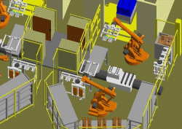
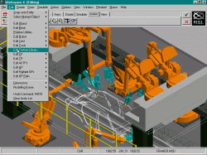
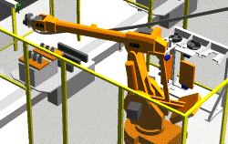
Workspace I
Environments & Robot simulation

Slide 14
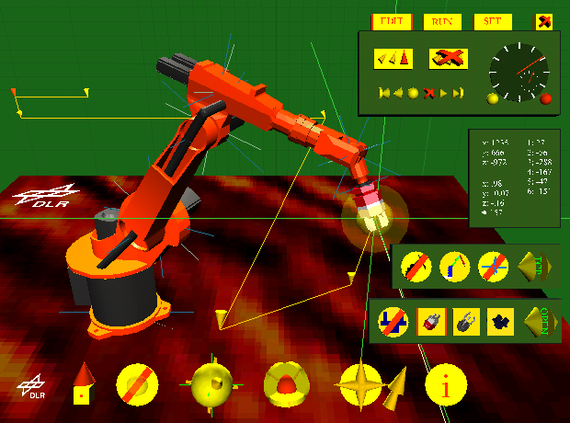
DLR : Kuka Robot
Tele-operation (simulation)

Slide 15
Reactivity & Deliberation
Social Robot Architecture

Slide 16
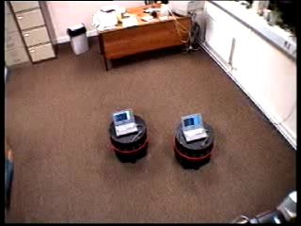
Reactivity & Deliberation
Social Robot Architecture
The Robot Waltz

Slide 17
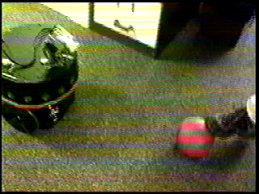
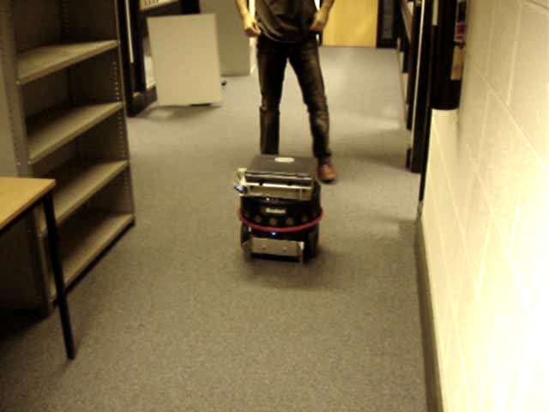
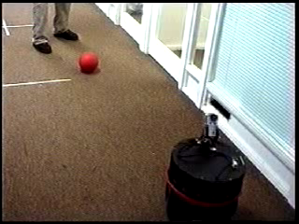
Real-Time Sensing
Ball Follow
Obstacle Avoidance

Slide 18

RUBICON (Robotic UBIquitous COgnitive Network)
FP7 STREP Call 6
Symbiotic Robot-WSN integration for cooperative activity recognition.
UCD [Ireland] Coordinator
OREBRO [Sweden]
Ulster University [UK]
CNR [Italy]
University of Pisa [Italy]
Tecnalia [Spain]
ROBOTNIK Ltd [Spain]

Slide 19

RUBICON Real Time Sensing

Slide 20
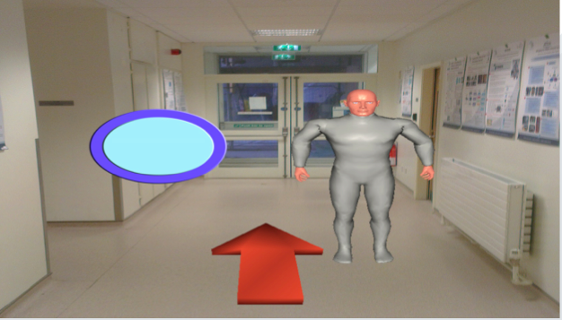
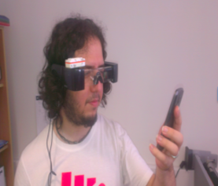
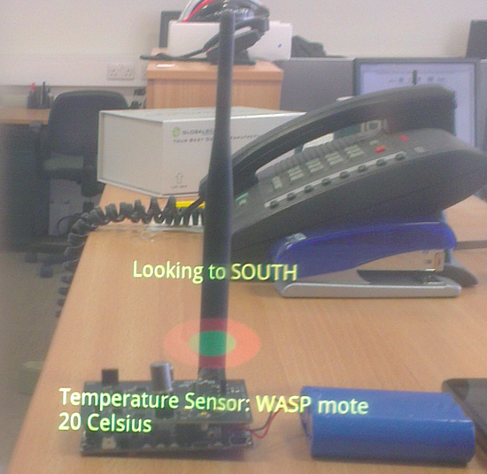
AuRA: Augmented Reality Interfaces

Slide 21
Reality & Virtual Reality
Real World
Virtual World

Slide 22
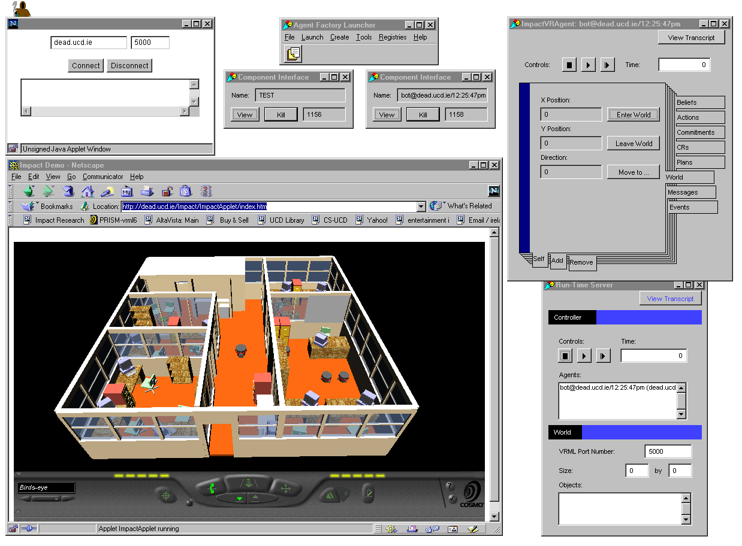
Virtual Reality Workbench
Virtual perspective of experiments

Slide 23
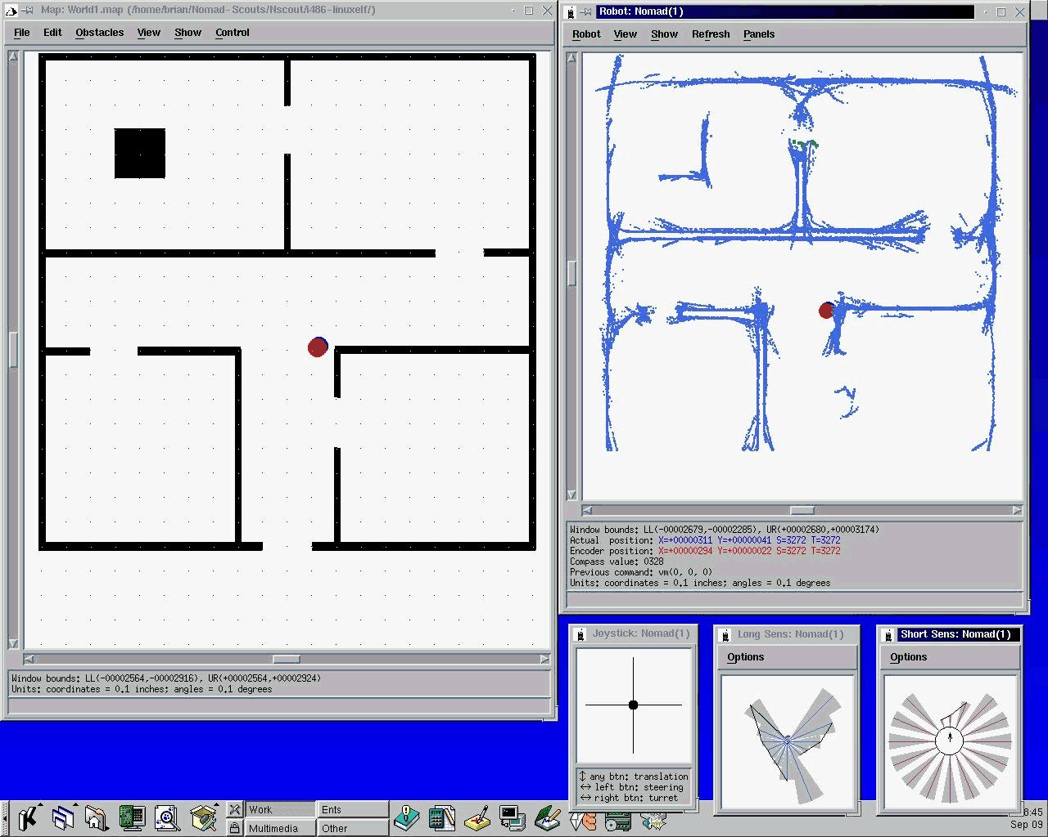
The Simulation Environment

Slide 24
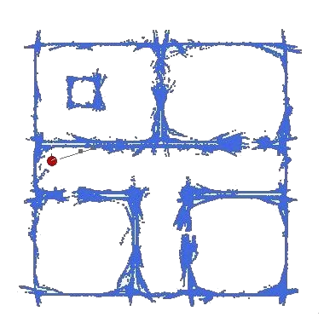
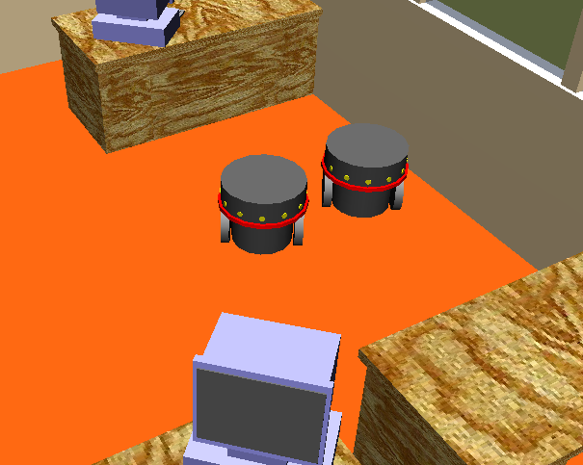
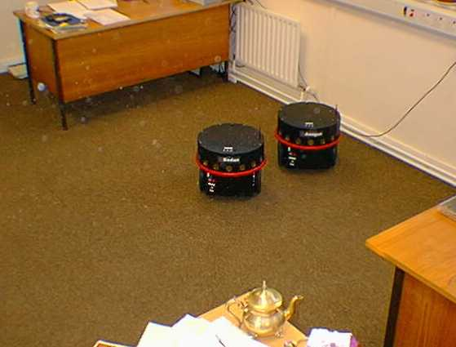
Synergy
Simulation
Reality
Virtual Reality

Slide 25
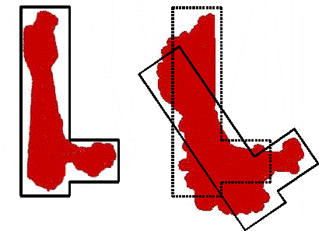
Robot Localisation
5 mins
25 mins

Slide 26
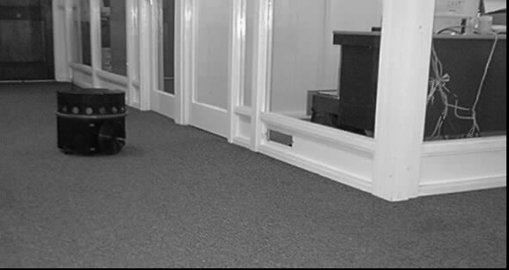
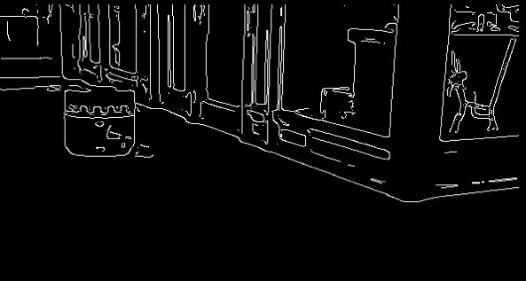
Vision: Image Processing I
Work in collaboration with:
Dr. Christophe Garcia
(ISR FORTH, Greece)
Edge Detection: Deriche Filter
optimisation of Canny filter
Contrast points
Line fitting: Hough transform
Door forms / Textures

Slide 27
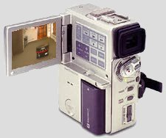
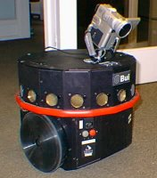

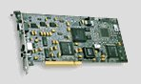
Vision Image Processing II
Sony DCR-PC1 Digital Camcorder

Slide 28
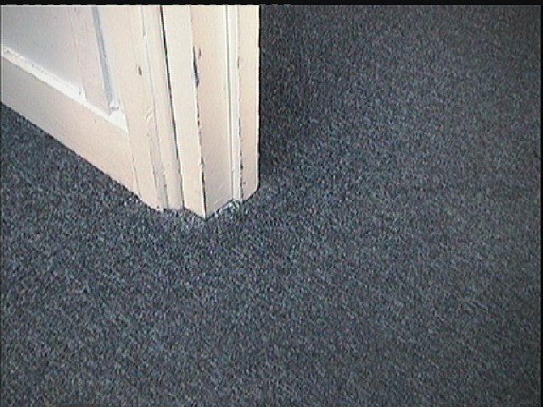
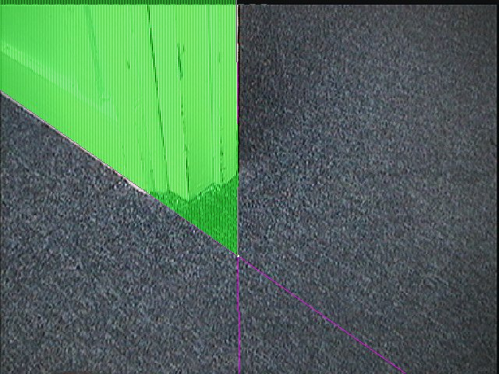
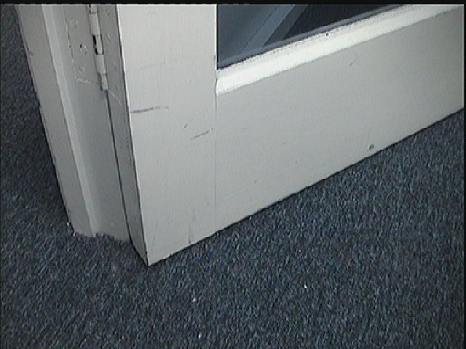
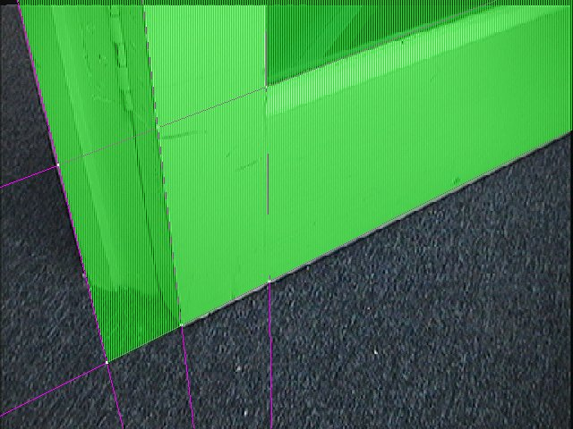
Vision : Image Processing III

Slide 29
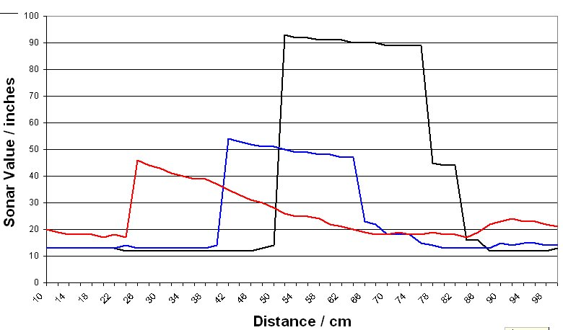
Sonar Signatures
Sensor fusion: sonar & vision

Slide 30
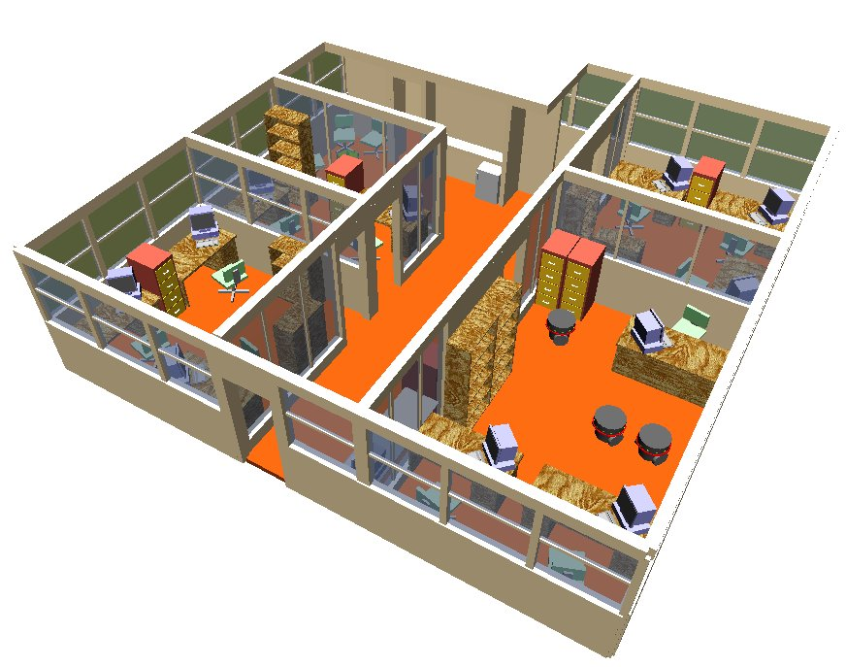
The Demonstration

Slide 31
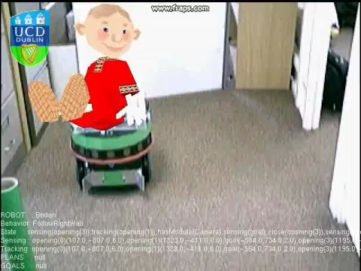
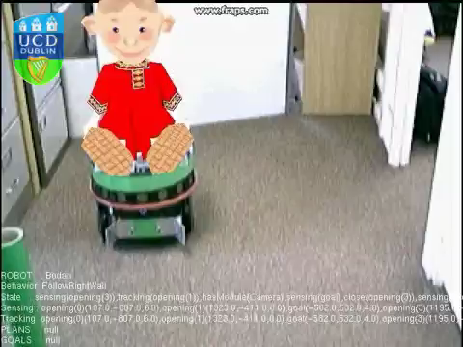
Mixed Reality Agents (MiRA)
Mixed Reality Sonor Depiction
Delivering the Promise of Personalised Robotics
Holz; T., Campbell;, A.G., O'Hare, G.M.P., Stafford; J.W., Martin, A. & Dragone, M, , MiRA- Mixed
Reality Agents, International Journal of Human Computer Studies, Elsevier Press, 2011.

Slide 32
Further Information
Sensor Fusion for Social Robotics
B.R. Duffy, C. Garcia, C.F.B. Rooney, G.M.P. O'Hare,
31st International Symposium on Robotics (ISR2000), May 14-17, 2000, Palais des congrès, Montréal, Canada, (In Press)
Reality and virtual reality in mobile robotics
B.R. Duffy, G.M.P. O'Hare, R.P.S. O'Donoghue, C.F.B. Rooney, R.W Collier,
Managing Interactions in Smart Environments (MANSE'99), Nixon, P., Lacey, G., Dobson, S. (Eds), Springer Verlag, ISBN 1-85233-228-X
What is a Social Robot?
B.R. Duffy, C.F.B. Rooney, G.M.P. O'Hare, R.P.S. O'Donoghue,
10th Irish Conference on Artificial Intelligence & Cognitive Science, 1-3 Sept., 1999 University College Cork, Ireland

Slide 33
Further Information
SOCIAL ROBOTICS: Reality and Virtuality in Agent-Based Robotics,
B.R. Duffy, R.W. Collier, G. M. P. O'Hare, C.F.B. Rooney, R.P.S. O'Donoghue
Bar-Ilan Symposium on the foundations of Artificial Intelligence: Bridging theory and practice
(BISFAI), 23-25 June 1999, Ramat Gan, Israel
The Social Robot Architecture: Towards Sociality in a Real World Domain,
C.F.B. Rooney, R.P.S. O'Donoghue, B.R. Duffy, G.M.P. O'Hare, R.W Collier,
Towards Intelligent Mobile Robots 99, Bristol, UK.

Slide 34

Things to Do!
Understand how Multi-agent systems may be deployed in the support of collaborative robotics;
Understand how the Social Robotic Architecture seamlessly integrates deliberative and reactive reasoning;
Understand how perceptions like sonar and activation of the bump sensors may be accommodated as Percepts and how they might be incorportaed into the BDI architecture.

